Slide 1
Implementation and Migrating to iModules
Jennifer McGee, Engagement Manager

Slide 2
Our Discussion Today
Introductions
The Project Team
Overview of Implementation
Decisions and Considerations

Slide 3
Client Project Roles
Project Manager (key role) – Commitment 50-100%
Technical Lead – Commitment 10-25%
Data Lead and Data Admin – Commitment 25-50%
Marketing and Design – Commitment 25-50%
Content Manager – Commitment 25-50%

Slide 4
iModules Project Roles
Project Manager – Primary contact during implementation
Data Team – Assists with data mapping, reporting, data sync configuration
Design Team – Provides creative design services
Training Team – Coordinates Build Training session and other training needs
Engagement Manager – Advises project planning, developing site goals, support through transitions.
Account Manager – Add-on projects, post launch manager

Slide 5
iModules Professional Services
Add-on service to assist with special projects:
Giving forms
Event registrations
Custom Directory configurations (ex: Career Networking, Report of Donors)
Content Management

Slide 6
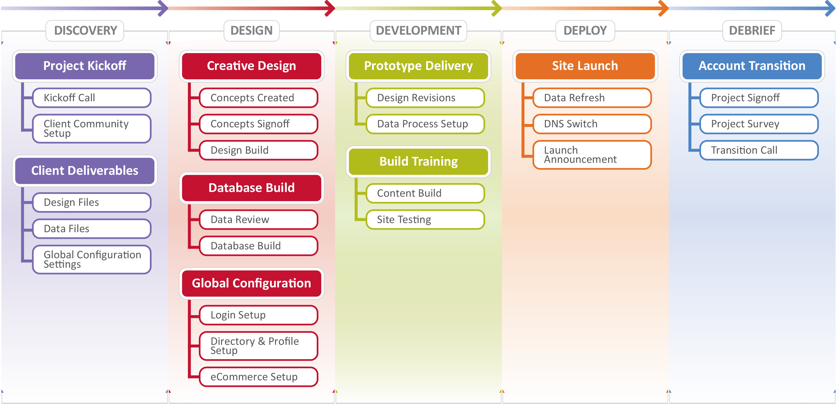
Overview of Implementation

Slide 7
I. Discovery Phase
Project Begins
Kickoff call with dedicated Project Manager
Project Manager delivers project plan
Client training (on-line and video tutorials)
Data Demo call: 30-60 minutes
Design call: 30-60 minutes
Global Configuration call: 60-90 minutes
Prepare marketing plan for site launch
Key Roles
Project Manager
Technical Lead
Data Lead
Data Admin
Designer
Content Manager Marketing
Notes:
PHASE 1, THE DISCOVER PHASE – WHICH IS ABOUT 6 WEEKS LONG, IS FOCUSED ON FULLY DEFINING THE DELIVERABLES NEEDED FOR YOUR SPECIFIC IMPLEMENTATION. THIS PHASE IS AN INTENSIVE PERIOD FOR CLIENTS DURING WHICH KEY DECISIONS ABOUT THE SITE ARE MADE – SO MOST OF YOUR PROJECT TEAM WILL BE INVOLVED AT SOME POINT DURING THIS PHASE.
DISCOVER BEGINS WITH A KICK-OFF CALL, IN WHICH YOU WILL MEET YOUR DEDICATED PROJECT MANAGER AT IMODULES AND YOU’LL REVIEW IN GREATER DETAIL THE PROJECT PLAN FOR YOUR IMPLEMENTATION.
SHORTLY AFTER THE KICK-OFF CALL, THE PROJECT MANAGER WILL GIVE YOUR TEAM ACCESS TO THE IMODULES CLIENT COMMUNITY WEBSITE, WHERE YOU CAN BEGIN ATTENDING WEB BASED MODULE TRAININGS TO FAMILIARLIZE YOURSELF WITH THE FUNCTIONALITY OF THE ENCOMPASS SYSTEM.
THE CLIENT COMMUNITY IS A RESOURCE FOR ALL IMODULES CLIENTS, WHICH NOT ONLY PROVIDES YOU WITH PRODUCT INFORMATION AND TRAINING BUT ALSO HAS A WEALTH OF INFORMATION ABOUT BEST PRACTICES, CLIENT SUCCESS STORIES, NETWORKING OPPORTUNITIES, AND UPCOMING PRODUCT RELEASES.
THE NEXT STEP AFTER THE KICK-OFF CALL IS THE DATA DEMO. THIS MEETING FOCUSES ON THE DATA NEEDS FOR YOUR ORGANIZATION AND SPECIFICALLY HOW TO GO ABOUT BUILDING THE DATA MAP FOR YOUR SITE.
YOU WILL ALSO HAVE A DESIGN CALL, WHICH IS FOCUSED ON DISCUSSING YOUR CREATIVE DESIGN NEEDS AND GATHERING THE INFORMATION NECESSARY FOR OUR DESIGN TEAM TO BEGIN BUILDING OUT THE CREATIVE ELEMENTS OF YOUR SITE.
FINALLY, YOUR TEAM WILL ALSO BE WORKING ON A GLOBAL CONFIGURATION DOCUMENT, WHICH WILL SPELL OUT THE SETTINGS AND VERBIAGE ON YOUR SITE – SUCH AS SITE NAME, DIRECTORY FIELDS, AND DEFINING THE CONSTITUENT LOGIN AND PROFILE EXPERIENCE.

Slide 8
II. Design Phase
Database Build
A complete data map received & reviewed
Database is built by iModules
Creative Design
Design workbook returned to iModules
Site design(s) iterations and sign off
Global Configuration Review
Controls system configurations (site name, login verbiage, email opt out categories, profile settings, etc…)
Global Configuration document returned to iModules
Key Roles
Project Manager
Data Lead
Data Admin
Designer
Content Manager
Notes:
PHASE 2 – THE DESIGN PHASE, IS ABOUT 10 WEEKS LONG. DURING THIS PHASE, IMODULES TAKES THE INFORMATION THAT YOU’VE PROVIDED FOR US ABOUT YOUR DESIGN, DATA, AND CONFIGURATION NEEDS, AND BUILDS OUT THE STRUCTURE OF YOUR SITE.
THE DATA MAP IS DELIVERED AND THE DATABASE IS BUILT.
THE CREATIVE DESIGN IS UNDERWAY AND CONCEPTS ARE DELIVERED TO YOUR TEAM FOR REVISIONS.
AND THE CONFIGURATION OF YOUR SITE IS ESTABLISHED AND IS BEING APPLIED.

Slide 9
III. Development Phase
Prototype Delivery
Database Build, Creative Design and Configuration are applied to temporary URL
(i.e. http://schoolname.imodules.com)
Verify global configurations, designs, etc
Training
Live modular training sessions & video tutorials
Build Training Sessions - Modular overviews with hands on build time with trainer and project manager
Launch Planning
Key Roles
Project Manager
Technical Lead
Data Lead
Data Admin
Designer
Content Manager
Marketing
Notes:
THE DEVELOPMENT PHASE, PHASE 3, IS THE LONGEST PHASE IN THE PROJECT AND TAKES ABOUT 13 WEEKS TO COMPLETE.
AT THE BEGINNING OF THE DEVELOPMENT PHASE IMODULES DELIVERS THE PROTOTYPE SITE WITH THE DATABASE AND CREATIVE DESIGNS IN PLACE.
THIS IS AN INTENSIVE PERIOD OF TESTING, TRAINING, AND CONTENT BUILDING FOR YOUR TEAM.
YOUR TEAM WILL HAVE ATTENDED ALL OF THE WEB MODULAR TRAININGS BY THIS TIME AND WILL BE READY FOR THE BUILD TRAINING SESSIONS.
THE BUILD TRAINING PROVIDES YOU WITH HANDS ON BUILD TIME WITH A TRAINER AND YOUR PROJECT MANAGER AND IS A KEY TIME FOR YOU TO DEDICATE TO DEVELOPING THE CONTENT OF YOUR SITE.
YOU’LL ALSO WANT TO USE THIS TIME TO FINALIZE THE DETAILS OF YOUR SITE LAUNCH PLAN AND ANY ASSOCIATED MARKETING AND COMMUNICATION YOU PLAN TO DO AROUND THE LAUNCH.

Slide 10
IV. Deploy
Site Launch
Verify changes are completed
Perform Data Refresh
Define Post Launch Support
DNS Conversion: A-Record pointed to iModules’ IP Address
Site Announcement
Schedule email/print announcements
Key Roles
Project Manager
Technical Lead
Data Lead
Data Admin
Notes:
PHASE 4 AND 5 ARE THE DEPLOYMENT AND DEBRIEFING PHASES OF THE IMPLEMENTATION.
BY THE TIME YOU REACH PHASE 4, YOU ARE READY TO LAUNCH YOUR SITE AND THE FINAL DETAILS OF THE LAUNCH ARE COMPLETED.
SHORTLY AFTER THE SITE LAUNCH, YOU WILL BE INTRODUCED TO YOUR DEDICATED ACCOUNT MANAGER, WHO WILL BE YOUR ONGOING ADVOCATE AND STRATEGIC PARTNER ONCE YOUR SITE IS LIVE.

Slide 11
V. Debrief
Post-Launch
Final Project Sign-Off
Transition Call with Account Manager
Project Survey
Key Roles
Project Manager
Notes:
PHASE 4 AND 5 ARE THE DEPLOYMENT AND DEBRIEFING PHASES OF THE IMPLEMENTATION.
BY THE TIME YOU REACH PHASE 4, YOU ARE READY TO LAUNCH YOUR SITE AND THE FINAL DETAILS OF THE LAUNCH ARE COMPLETED.
SHORTLY AFTER THE SITE LAUNCH, YOU WILL BE INTRODUCED TO YOUR DEDICATED ACCOUNT MANAGER, WHO WILL BE YOUR ONGOING ADVOCATE AND STRATEGIC PARTNER ONCE YOUR SITE IS LIVE.

Slide 12
Decisions and Considerations
Reporting
Payment gateway
Authentication Method
Creative Design
Launch Date
Notes:
Audience segmentation: Do you segment your communities/audience now? Do you want to continue or make a change in the new system?
Admin structure: Do you now or will you limit staff access to data or tools?
Data fields: More about that in the next slides. It’s not too early to begin thinking about your data needs and management plan
Reporting needs: What reports do you use now? Do you want to replicate that in the system? Do you want to make changes?
Payment Gateway: Cybersource is one of many payment gateways supported by iModules. We can provide you with the full list if you are considering leaving Cybersource.
Authentication Method: How will your constituents access the site?
Creative Design: Will you provide the design or will iModules create a custom site design?
Launch date: Do you have a launch data in mind? If so, what’s driving that date?

Slide 13
Questions?
Jennifer McGee - jmcgee@imodules.com
Gail Palmer – gpalmer@imodules.com
Greg Knue – gknue@imodules.com

